Slide 1
Computer Organization
CSE 230 Computer Organization
Lecture 2
Computer Organization
© Gamal Fahmy

Slide 2
Computer Architecture and Organization
Execution time for any program depends on:
  Number of inst.
  Avg. clock cycle per inst.
  Time per clock cycle
Architecture
Organization
IC_Technology
MAR
MDR
These factors are inter related
ALU
PC
IR
Control Unit
General Purpose Registers
I/O units
© Gamal Fahmy

Slide 3
Single Bus and double Bus Architectures
MAR
MAR
MDR
MDR
PC
PC
IR
IR
ALU
ALU
Control Unit
Control Unit
General Purpose Registers
I/O units
General Purpose Registers
I/O units
© Gamal Fahmy

Slide 4
Structure & Function
Structure is the way in which components relate to each other
Function is the operation of individual components as part of the structure
© Gamal Fahmy

Slide 5
Function
All computer functions are:
  Data processing
  Data storage
  Data movement
  Control
© Gamal Fahmy

Slide 6
Functional view
Functional view of a computer
Data
Storage
Facility
Data
Movement
Apparatus
Control
Mechanism
Data
Processing
Facility
© Gamal Fahmy

Slide 7
Operations (1)
Data movement
  e.g. keyboard to screen
Data
Storage
Facility
Data
Movement
Apparatus
Control
Mechanism
Data
Processing
Facility
© Gamal Fahmy

Slide 8
Operations (2)
Storage
  e.g. Internet download to disk
Data
Storage
Facility
Data
Movement
Apparatus
Control
Mechanism
Data
Processing
Facility
© Gamal Fahmy

Slide 9
Operation (3)
Processing from/to storage
  e.g. updating bank statement
Data
Storage
Facility
Data
Movement
Apparatus
Control
Mechanism
Data
Processing
Facility
© Gamal Fahmy

Slide 10
Operation (4)
Processing from storage to I/O
  e.g. printing a bank statement
Data
Storage
Facility
Data
Movement
Apparatus
Control
Mechanism
Data
Processing
Facility
© Gamal Fahmy

Slide 11
Structure - Top Level
Peripherals
Computer
Central
Processing
Unit
Main
Memory
Computer
Systems
Interconnection
Input
Output
Communication
lines
© Gamal Fahmy

Slide 12
Structure - The CPU
CPU
Computer
Arithmetic
and
Login Unit
I/O
Registers
System
Bus
CPU
Internal CPU
Interconnection
Memory
Control
Unit
© Gamal Fahmy

Slide 13
Structure - The Control Unit
Control Unit
CPU
ALU
Sequencing
Login
Internal
Bus
Control
Unit
Control Unit
Registers and
Decoders
Registers
Control
Memory
© Gamal Fahmy

Slide 14
Structure of von Nuemann machine
Arithmetic and Logic Unit
Input
Output
Equipment
Main
Memory
Program Control Unit
© Gamal Fahmy

Slide 15
IAS - details
1000 x 40 bit words
  Binary number
  2 x 20 bit instructions
Set of registers (storage in CPU)
  Memory Buffer Register (MBR or MDR)
  Memory Address Register
  Instruction Register
  Instruction Buffer Register
  Program Counter
  Accumulator
  Multiplier Quotient
© Gamal Fahmy

Slide 16
Connecting
All the units must be connected
Different type of connection for different type of unit
  Memory
  Input/Output
  CPU
© Gamal Fahmy

Slide 17
Memory Connection
Receives and sends data
Receives addresses (of locations)
Receives control signals
  Read
  Write
  Timing
© Gamal Fahmy

Slide 18
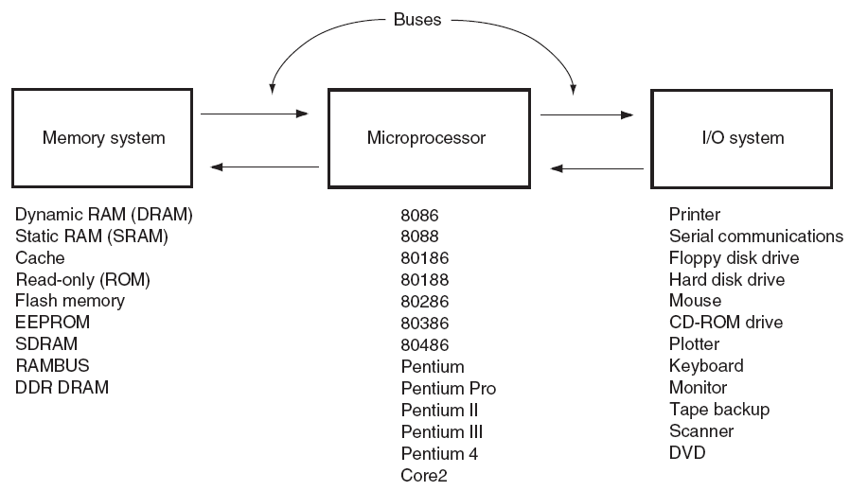
The Microprocessor-Based Computer System
The block diagram of a computer system:

Slide 19
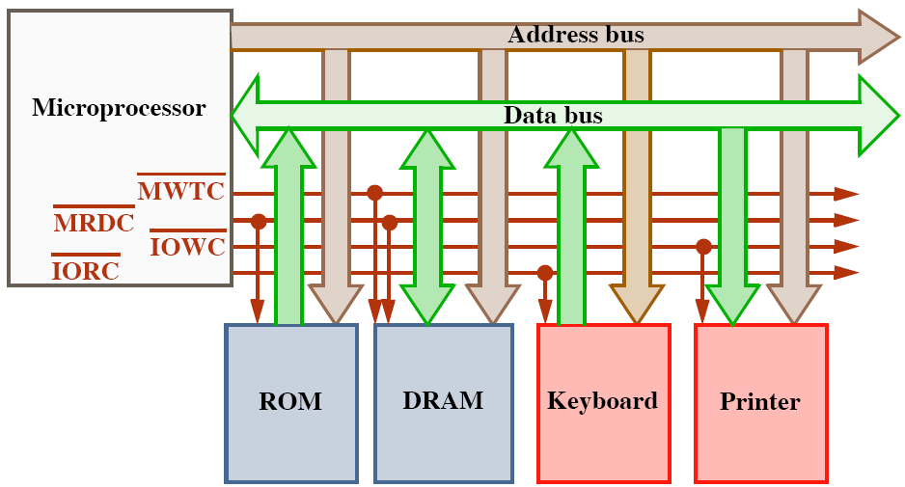
Important Definitions & Concepts
What are the buses?
  A common group of wires that interconnect components in a computer system.
  Transfer address, data, & control information between µP, memory and I/O.
  Three buses exist for this transfer of information: address, data, and control.
Control Bus
Control Signals

Slide 20
Input/Output Connection(1)
Similar to memory from computer’s viewpoint
Output
  Receive data from computer
  Send data to peripheral
Input
  Receive data from peripheral
  Send data to computer
© Gamal Fahmy

Slide 21
Input/Output Connection(2)
Receive control signals from computer
Send control signals to peripherals
  e.g. spin disk
Receive addresses from computer
  e.g. port number to identify peripheral
Send interrupt signals (control)
© Gamal Fahmy

Slide 22
CPU Connection
Reads instruction and data
Writes out data (after processing)
Sends control signals to other units
Receives (& acts on) interrupts
© Gamal Fahmy

Slide 23
Buses
There are a number of possible interconnection systems
Single and multiple BUS structures are most common
e.g. Control/Address/Data bus (PC)
e.g. Unibus (DEC-PDP)
© Gamal Fahmy

Slide 24
What is a Bus?
A communication pathway connecting two or more devices
Usually broadcast
Often grouped
  A number of channels in one bus
  e.g. 32 bit data bus is 32 separate single bit channels
Power lines may not be shown
© Gamal Fahmy

Slide 25
Data Bus
Carries data
  Remember that there is no difference between “data” and “instruction” at this level
Width is a key determinant of performance
  8, 16, 32, 64 bit
© Gamal Fahmy

Slide 26
Address bus
Identify the source or destination of data
e.g. CPU needs to read an instruction (data) from a given location in memory
Bus width determines maximum memory capacity of system
  e.g. 8080 has 16 bit address bus giving 64k address space
© Gamal Fahmy

Slide 27
Control Bus
Control and timing information
  Memory read/write signal
  Interrupt request
  Clock signals
© Gamal Fahmy

Slide 28

Bus Interconnection Scheme
© Gamal Fahmy

Slide 29
Big and Yellow?
What do buses look like?
  Parallel lines on circuit boards
  Ribbon cables
  Strip connectors on mother boards
    e.g. PCI
  Sets of wires
© Gamal Fahmy

Slide 30
Single Bus Problems
Lots of devices on one bus leads to:
  Propagation delays
    Long data paths mean that co-ordination of bus use can adversely affect performance
    If aggregate data transfer approaches bus capacity
Most systems use multiple buses to overcome these problems
© Gamal Fahmy

Slide 31

Traditional (ISA) (with cache)
© Gamal Fahmy

Slide 32
High Performance Bus
© Gamal Fahmy

Slide 33
Bus Types
Dedicated:
  A dedicated bus line is permanently authorized either to one function or a physical subgroup of computer components.
  Separate data & address lines
Multiplexed
  A multiplexed bus line is assigned too many functions based on some parameters.
  Shared lines
  Address valid or data valid control line
  Advantage - fewer lines
  Disadvantages
    More complex control
    Ultimate performance
© Gamal Fahmy

Slide 34
Bus Arbitration التحكم
More than one module controlling the bus
e.g. CPU and DMA (Direct Memory Access) controller
Only one module may control bus at one time
Arbitration may be centralised or distributed
© Gamal Fahmy

Slide 35
Timing
Co-ordination of events on bus
Synchronous
  Events determined by clock signals
  Control Bus includes clock line
  A single 1-0 is a bus cycle
  All devices can read clock line
  Usually sync on leading edge
  Usually a single cycle for an event
© Gamal Fahmy

Slide 36
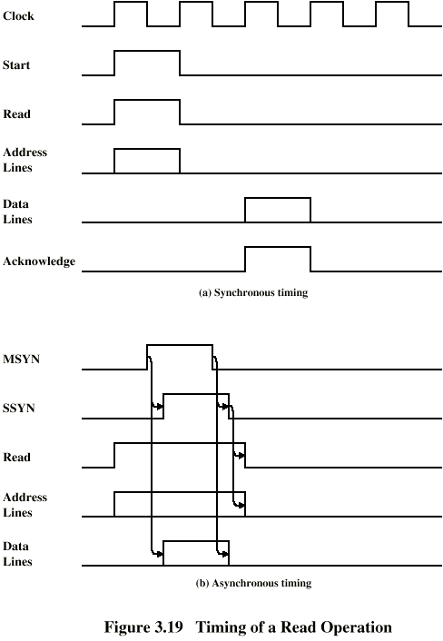
Synchronous Timing Diagram
© Gamal Fahmy

Slide 37
Asynchronous Timing Diagram
© Gamal Fahmy

Slide 38
PCI Bus
Peripheral Component Interconnection
Intel released to public domain
32 or 64 bit
50 lines
© Gamal Fahmy

Slide 39
Architecture and Organization
Architecture deal with design aspects outside the micro processor, or in the micro processor interface
Organization deals with totally inside processor aspects
For multiply, if it means there is a hardware multiplier, then it is an architectural issue, if it will result in repeated additions it will be an organizational issue.
© Gamal Fahmy

Slide 40
Computer Architecture and Organization
Computer Architecture is defined as the science and art of selecting and interconnecting hardware components to create computers that meet functional, performance and cost goals (John Hennessy)
Computer Organization is defined as the implementation of these blocks and how each block functions independently
I can have 2 computers that have the same processor brand, same number of internal register, same instruction set, same format for operand in both memory and CPU registers, but they have different memory sizes, different processor frequency, different bus structure between the CPU and memory and I/O devices, and different instruction execution time.
© Gamal Fahmy

